Slide 1
Data Communications and Networking
Chapter 10
Circuit Switching and Packet Switching
References:
Book Chapter 10.1 , 10.2, 10.5
Data and Computer Communications, 8th edition
By William Stallings

Slide 2
Overview
Networks are used to interconnect many devices.
We have checked with Local Area Networks.
Now, wide area networks
  Since the invention of the telephone, circuit switching has been the dominant technology for voice communications.
  Since 1970, packet switching has evolved substantially for digital data communications. It was designed to provide a more efficient facility than circuit switching for bursty data traffic.
    Two types of packet switching:
      Datagram (such as today’s Internet)
      Virtual circuit (such as Frame Relay, ATM)

Slide 3
Switched Communications Networks
Long distance transmission between stations (called “end devices”) is typically done over a network of switching nodes.
Switching nodes do not concern with content of data. Their purpose is to provide a switching facility that will move the data from node to node until they reach their destination (the end device).
A collection of nodes and connections forms a communications network.
In a switched communications network, data entering the network from a station are routed to the destination by being switched from node to node.

Slide 4
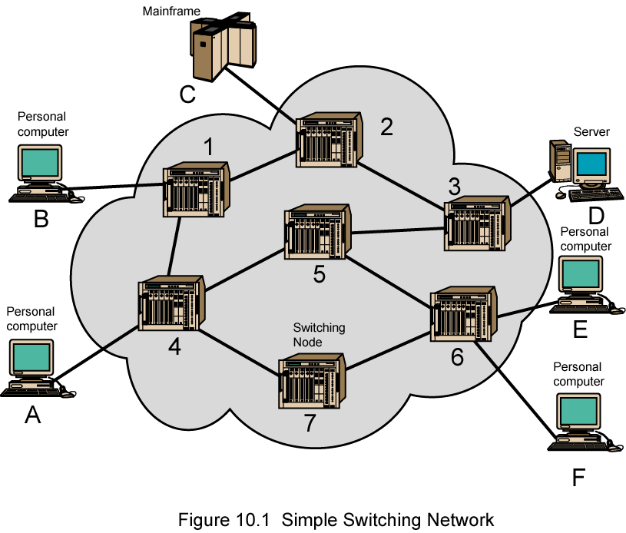
Simple Switching Network

Slide 5
Switching Nodes
Nodes may connect to other nodes, or to some stations.
Network is usually partially connected
  However, some redundant connections are desirable for reliability
Two different switching technologies
  Circuit switching
  Packet switching

Slide 6
Circuit Switching
Circuit switching:
  There is a dedicated communication path between two stations (end-to-end)
  The path is a connected sequence of links between network nodes. On each physical link, a logical channel is dedicated to the connection.
Communication via circuit switching has three phases:
  Circuit establishment (link by link)
    Routing & resource allocation (FDM or TDM)
  Data transfer
  Circuit disconnect
    Deallocate the dedicated resources
The switches must know how to find the route to the destination and how to allocate bandwidth (channel) to establish a connection.

Slide 7
Points to be noted
Circuit switching takes place at the physical layer.
Before starting communication, the stations must make a reservation for the resources to be used during the communication. These resources, such as channels (bandwidth in FDM and time slots in TDM), switch buffers, switch processing time, and switch input/output ports, must remain dedicated during the entire duration of data transfer until the teardown phase.
The data are a continuous flow sent by the source station and received by the destination station, although there may be periods of silence.
There is no addressing involved during data transfer.

Slide 8
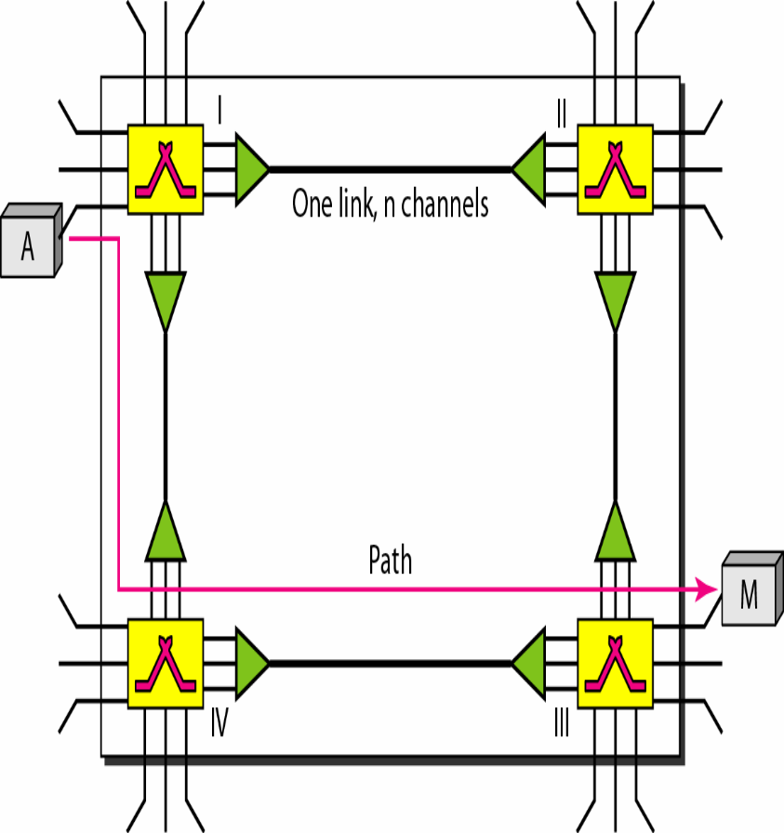
Communication Phases in Circuit Switch Network
Setup Phase:
  Before the two parties (or multiple parties in a conference call) can communicate, a dedicated circuit (combination of channels in links) needs to be established.
  In the next step to making a connection, an acknowledgment from receiver needs to be sent in the opposite direction to sender. Only after sender receives this acknowledgment is the connection established.

Slide 9
Data Transfer Phase:
  After the establishment of the dedicated circuit (channels), the two parties can transfer data.
Teardown Phase
  When one of the parties needs to disconnect, a signal is sent to each switch to release the resources.

Slide 10
Circuit Switching Properties
Inefficiency
  Channel capacity is dedicated for the whole duration of a connection
  If no data, capacity is wasted
Delay
  Long initial delay: circuit establishment takes time
  Low data delay: after the circuit establishment, information is transmitted at a fixed data rate with no delay other than the propagation delay. The delay at each node is negligible.
Developed for voice traffic (public telephone network) but can also applied to data traffic.
  For voice connections, the resulting circuit will enjoy a high percentage of utilization because most of the time one party or the other is talking.
  But how about data connections?

Slide 11
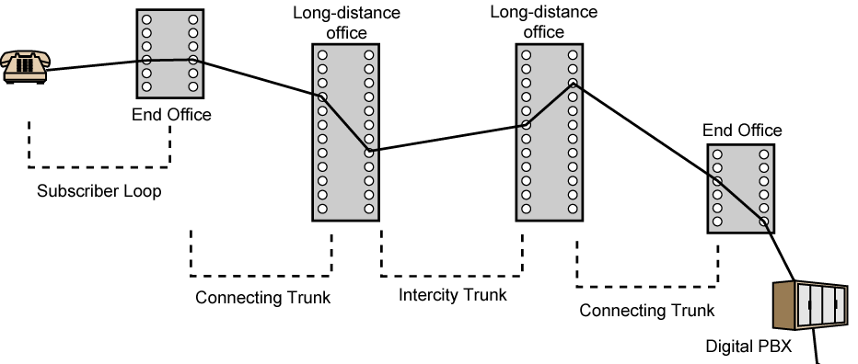
Public Circuit Switched Network
Subscribers: the devices that attach to the network.
Subscriber loop: the link between the subscriber and the network.
Exchanges: the switching centers in the network.
End office: the switching center that directly supports subscribers.
Trunks: the branches between exchanges. They carry multiple voice-frequency circuits using either FDM or synchronous TDM.

Slide 12
Problem of circuit switching
  designed for voice service
  Resources dedicated to a particular call
  For data transmission, much of the time the connection is idle (say, web browsing)
  Data rate is fixed
    Both ends must operate at the same rate during the entire period of connection
Packet switching is designed to address these problems.

Slide 13
Datagram Networks
In data communications, we need to send messages from one end system to another. If the message is going to pass through a packet-switched network, it needs to be divided into packets of fixed or variable size. The size of the packet is determined by the network and the governing protocol.
In packet switching, there is no resource allocation for a packet. This means that there is no reserved bandwidth on the links, and there is no scheduled processing time for each packet.
Resources are allocated on demand.
Datagram switching is normally done at the network layer.
The datagram networks are sometimes referred to as connectionless networks.
The term connectionless here means that the switch (packet switch) does not keep information about the connection state. There are no setup or teardown phases. Each packet is treated the same by a switch regardless of its source or destination.

Slide 14
Basic Operation
Data are transmitted in short packets
  Typically at the order of 1000 bytes
  Longer messages are split into series of packets
  Each packet contains a portion of user data plus some control info
Control info contains at least
  Routing (addressing) info, so as to be routed to the intended destination
store and forward
  On each switching node, packets are received, stored briefly (buffered) and passed on to the next node.
  The allocation is done on a first come, first-served basis. When a switch receives a packet, no matter what is the source or destination, the packet must wait if there are other packets being processed.

Slide 15
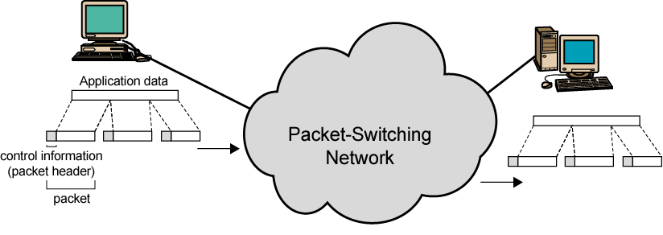
Use of Packets

Slide 16
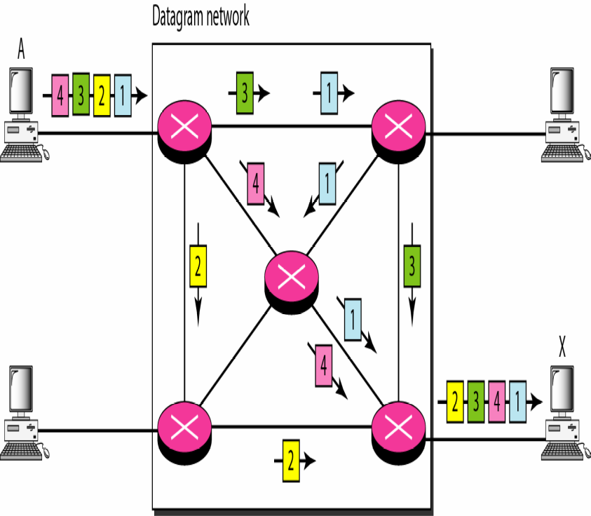
An Example
All four packets (or datagrams) belong to the same message, but may travel different paths to reach their destination.
This approach can cause the datagrams of a transmission to arrive at their destination out of order with different delays between the packets.
Packets may also be lost or dropped because of a lack of resources.
In most protocols, it is the responsibility of an upper-layer protocol to reorder the datagrams or ask for lost datagrams before passing them on to the application.

Slide 17
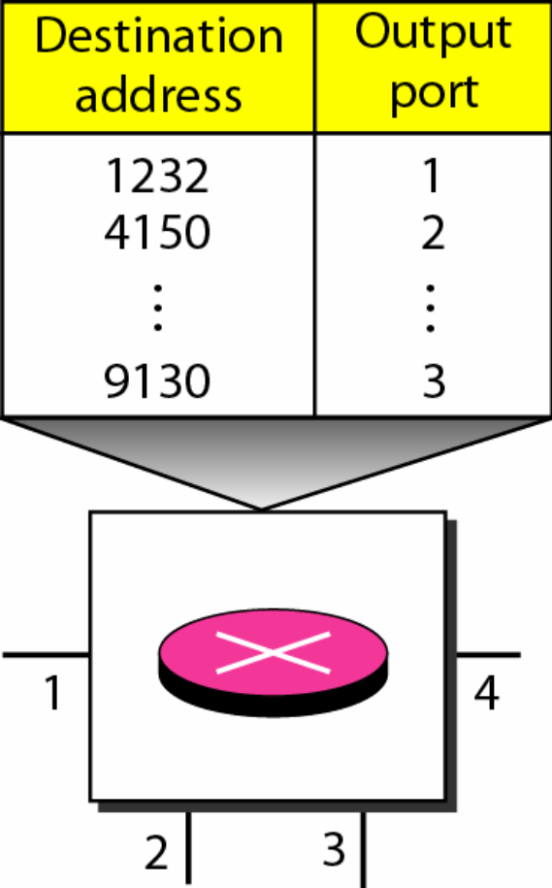
Routing table & Destination Add.
A switch in a datagram network uses a routing table that is based on the destination address.
The destination address in the header of a packet in a datagram network remains the same during the entire journey of the packet.
Data Communication

Slide 18
Advantages of Packet Switching
Line efficiency
  Single node-to-node link can be dynamically shared by many packets over time
  Packets are queued up and transmitted as fast as possible
  If a source sends a packet and there is a delay of a few minutes before another packet can be sent, the resources can be reallocated during these minutes for other packets from other sources.
Data rate conversion
  Each station connects to the local node at its own speed
In circuit-switching, a connection could be blocked if there lacks free resources. On a packet-switching network, even with heavy traffic, packets are still accepted, by delivery delay increases.
Priorities can be used
  On each node, packets with higher priority can be forwarded first. They will experience less delay than lower-priority packets.

Slide 19

Packet switching versus circuit switching
A
Circuit switching
2 circuits (use TDM)
A reserves 1 circuit
B reserves 1 circuit
B
2 Mb/s
Utilization = 50% only = 1 Mb/s
B: has no
packets to send
A
Packet switching
statistical multiplex.
B uses full link since
A is not using it
B
2 Mb/s
Utilization = 100% = 2 Mb/s
Chapter 1, slide:

Slide 20

Delay
There may be greater delay in a datagram network than in a virtual-circuit network.
Although there are no setup and teardown phases, each packet may experience a wait at a switch before it is forwarded.
In addition, since not all packets in a message necessarily travel through the same switches, the delay is not uniform for the packets of a message.
Data Communication

Slide 21
Packet Switching Technique
A station breaks long message into packets
Packets are sent out to the network sequentially, one at a time
How will the network handle this stream of packets as it attempts to route them through the network and deliver them to the intended destination?
  Two approaches
    Datagram approach
    Virtual circuit approach

Slide 22
Datagram
Each packet is treated independently, with no reference to packets that have gone before.
  Each node chooses the next node on a packet’s path.
Packets can take any possible route.
Packets may arrive at the receiver out of order.
Packets may go missing.
It is up to the receiver to re-order packets and recover from missing packets.
Example: Internet

Slide 23
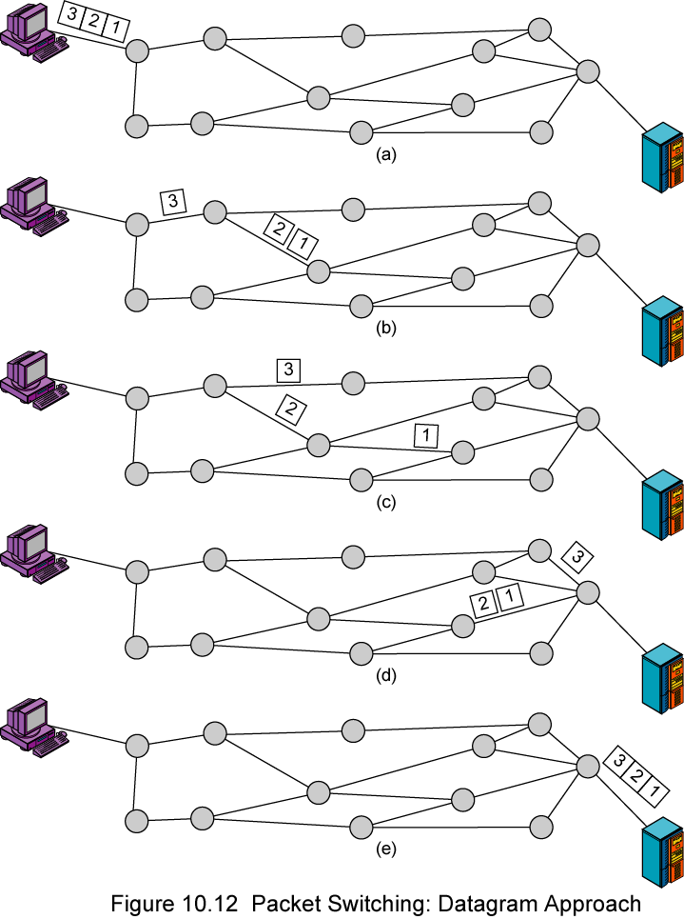
Datagram

Slide 24
Virtual Circuit Network
A virtual-circuit network is a cross between a circuit-switched network and a datagram network.
Characteristics
  As in a circuit-switched network, there are setup and teardown phases in addition to the data transfer phase.
  The call request and call accept packets are used to establish a connection
  Resources can be allocated during the setup phase, as in a circuit-switched network, or on demand, as in a datagram
  Data are packetized and each packet carries an address in the header but the address in the header is not for the destination computer, it is the address of the next switch and the channel on which the packet is being carried.

Slide 25
Virtual Circuit Network (Cont..)
  As in circuit switched network, all packets follow the same path during the connection
  Implemented in data link layer whereas circuit-switched network is implemented in physical layer and packet-switched network is implemented in network layer

Slide 26
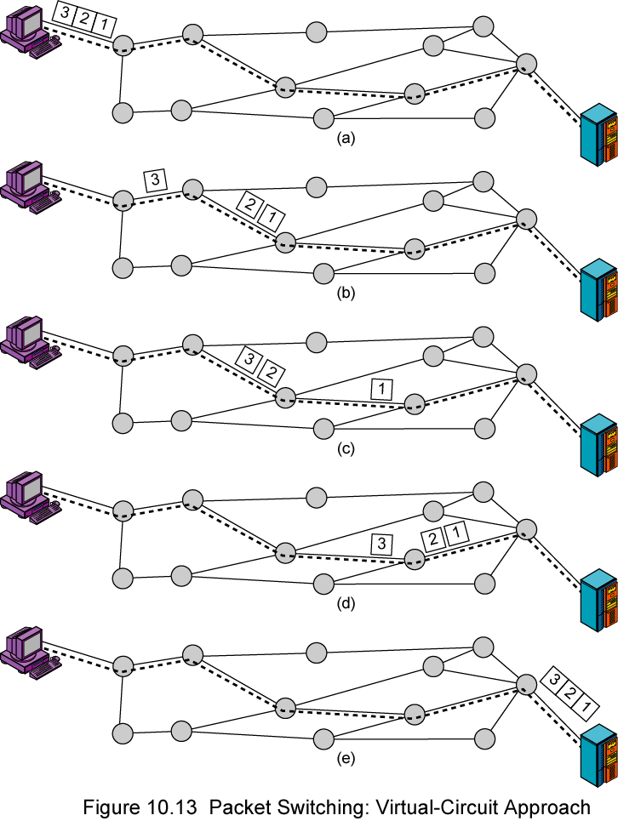
Virtual
Circuit
A route between stations is set up prior to data transfer.
At each switch between source to destination:
  Based on destination address creates a mapping of incoming VCI port to outgoing VCI port
  At a switch, for each connection, VCI on a port is unique
  VCI field can be much smaller than an address field

Slide 27

Addressing
Global addressing:
Virtual-circuit identifier
Data Communication

Slide 28
Addressing
Global addressing
  A source or a destination needs to have a global address-an address that can be unique in the scope of the network or internationally if the network is part of an international network.
Virtual Circuit Identifier:
  The identifier that is actually used for data transfer is called the virtual-circuit identifier (VCI). A VCI, unlike a global address, is a small number that has only switch scope; it is used by a frame between two switches. When a frame arrives at a switch, it has a VCI; when it leaves, it has a different VCl.
Data Communication

Slide 29
Three Phases
Data Transfer Phase:
  To transfer a frame from a source to its destination, all switches need to have a table entry (just like packet switching) for this virtual circuit.
  The table, in its simplest form, has four columns.
  This means that the switch holds four pieces of information for each virtual circuit that is already set up.

Slide 30
Data Transfer Phase (Cont.)
Figure shows a frame arriving at port 1 with a VCI of 14.
When the frame arrives, the switch looks in its table to find port 1 and a VCI of 14. When it is found, the switch knows to change the VCI to 22 and send out the frame from port 3.

Slide 31
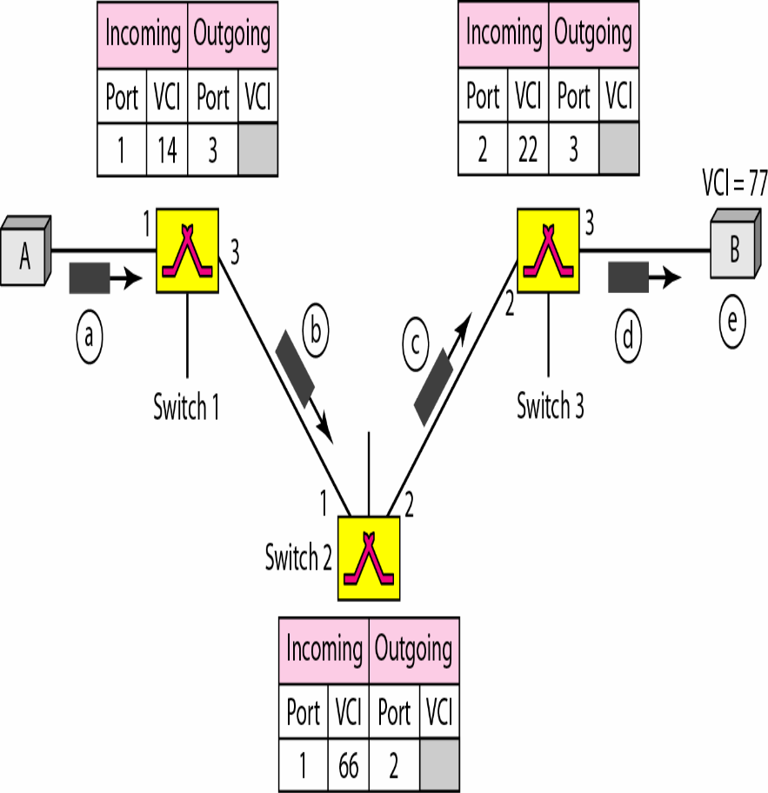

Figure shows how a frame reaches from source A to destination B and how VCI changes during this trip

Slide 32
Three Phrases (Cont..)
Setup Phase:
  In the setup phase, a switch creates an entry for a virtual circuit.
  For example, suppose source A needs to create a virtual circuit to B. Two steps are required: the setup request and the acknowledgment.
  Setup Request: A setup request frame is sent from the source to the destination.
  Figure shows the process.

Slide 33
Setup
a. Source A sends a setup frame to switch 1.
b. Switch 1 receives the setup request frame. It knows that a frame going from A to B goes out through port 3.
The switch creates an entry in its table for this virtual circuit, but it is only able to fill three of the four columns.
The switch assigns the incoming port (1) and chooses an available incoming VCI (14) and the outgoing port (3). It does not yet know the outgoing VCI, which will be found during the acknowledgment step. The switch then forwards the frame through port 3 to switch 2.

Slide 34
Setup
c. Switch 2 receives the setup request frame. The same events happen here as at switch 1; three columns of the table are completed: in this case, incoming port (l), incoming VCI (66), and outgoing port (2).
d. Switch 3 receives the setup request frame. Again, three columns are completed:
e. Destination B receives the setup frame, and if it is ready to receive frames from A, it assigns a VCI to the incoming frames that come from A, in this case 77. This VCI lets the destination know that the frames come from A, and not other sources.

Slide 35
Acknowledgement
The destination sends an acknowledgment to switch 3.
The acknowledgment carries the global source and destination addresses so the switch knows which entry in the table is to be completed. The frame also carries VCI 77, chosen by the destination as the incoming VCI for frames from A.
Switch 3 uses this VCI to complete the outgoing VCI column for this entry

Slide 36
b. Switch 3 sends an acknowledgment to switch 2 that contains its incoming VCI in the table, chosen in the previous step. Switch 2 uses this as the outgoing VCI in the table.
c. Finally switch 1 sends an acknowledgment to source A that contains its incoming VCI in the table, chosen in the previous step.
d. The source uses this as the outgoing VCI for the data frames to be sent to destination B.

Slide 37
Three Phases (Cont.)
Teardown Phase
  In this phase, source A, after sending all frames to B, sends a special frame called a teardown request.
  Destination B responds with a teardown confirmation frame. All switches delete the corresponding entry from their tables.

Slide 38
Virtual Circuits v Datagram
Virtual circuits
  Network can provide sequencing (packets arrive at the same order) and error control (retransmission between two nodes).
  Packets are forwarded more quickly
    Based on the virtual circuit identifier
    No routing decisions to make
  Less reliable
    If a node fails, all virtual circuits that pass through that node fail.
Datagram
  No call setup phase
    Good for bursty data, such as Web applications
  More flexible
    If a node fails, packets may find an alternate route
    Routing can be used to avoid congested parts of the network

Slide 39
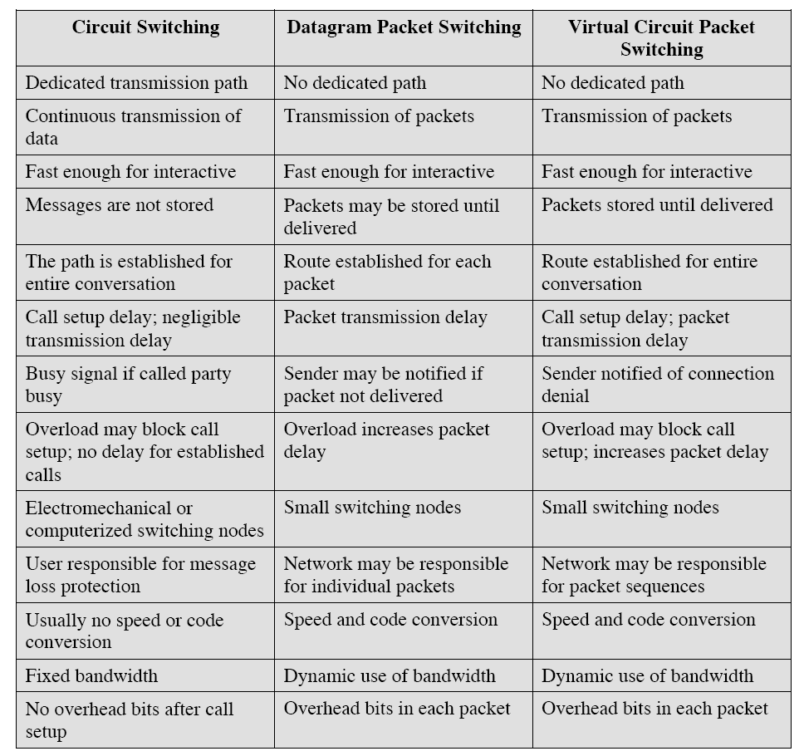
Comparison of communication switching techniques

